Slide 1
CTMC – Continuous Time Markov Chains
Christian M. Adriano (Chris)
christian.adriano@hpi.de
Notes:
https://en.wikipedia.org/wiki/Transduction_(machine_learning)

Slide 2
Topics
Questions w.r.t. CTMC
Data Sampling
Fitting Distributions

Slide 3
Project-1: Use of DTMC to Predict Event Masking

Slide 4
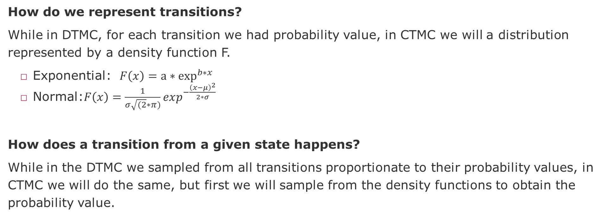
Questions
How do we represent transitions?
While in DTMC, for each transition we had probability value, in CTMC we will a distribution represented by a density function F.
Exponential: $F\left(x\right)=a∗\exp^{b∗x}{ }$
Normal:$F\left(x\right)=\frac{1}{σ\sqrt{(2}∗π)}exp^{−\frac{{\left(x−μ\right)}^{2}}{2∗σ}}$
How does a transition from a given state happens?
While in the DTMC we sampled from all transitions proportionate to their probability values, in CTMC we will do the same, but first we will sample from the density functions to obtain the probability value.

Slide 5
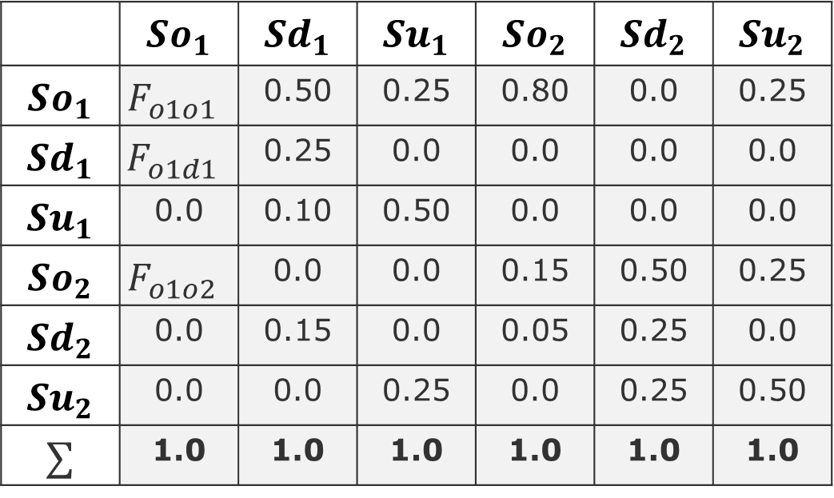
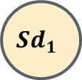
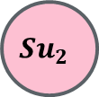
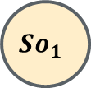
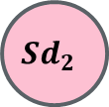
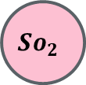

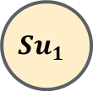
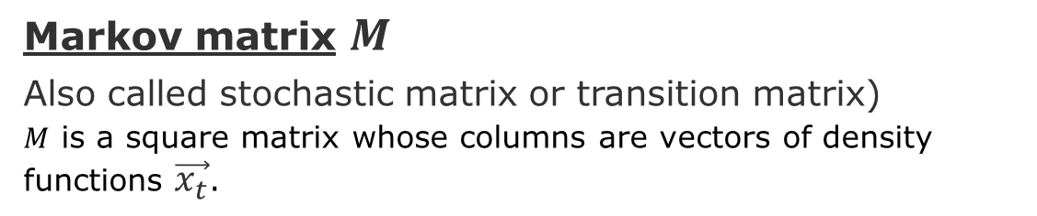
Example of Markov Chain
Markov matrix $M$
Also called stochastic matrix or transition matrix)
$M$ is a square matrix whose columns are vectors of density functions $\vec{x_{t}}$.
$$So_{1}$$
$$Sd_{1}$$
Sampled from the density function $F_{d1o1}$
$$Su_{1}$$
$$\vec{x_{t}}$$
Source states
 | $$So_{1}$$ | $$Sd_{1}$$ | $$Su_{1}$$ | $$So_{2}$$ | $$Sd_{2}$$ | $$Su_{2}$$
$$So_{1}$$ | $$F_{o1o1}$$ | 0.50 | 0.25 | 0.80 | 0.0 | 0.25
$$Sd_{1}$$ | $$F_{o1d1}$$ | 0.25 | 0.0 | 0.0 | 0.0 | 0.0
$$Su_{1}$$ | 0.0 | 0.10 | 0.50 | 0.0 | 0.0 | 0.0
$$So_{2}$$ | $$F_{o1o2}$$ | 0.0 | 0.0 | 0.15 | 0.50 | 0.25
$$Sd_{2}$$ | 0.0 | 0.15 | 0.0 | 0.05 | 0.25 | 0.0
$$Su_{2}$$ | 0.0 | 0.0 | 0.25 | 0.0 | 0.25 | 0.50
$$∑$$ | 1.0 | 1.0 | 1.0 | 1.0 | 1.0 | 1.0
$$Su_{2}$$
$$So_{2}$$
$$Sd_{2}$$
Target states
Intentionally not showing the self-loops

Slide 6
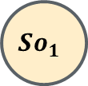
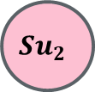


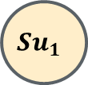
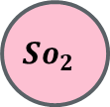
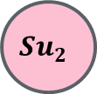
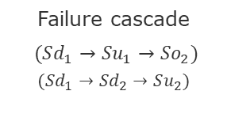
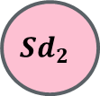

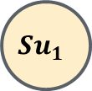

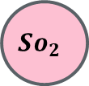


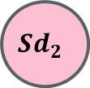
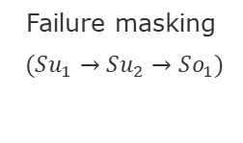
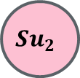

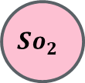
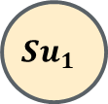
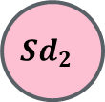
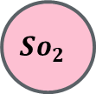
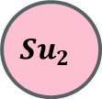
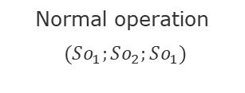
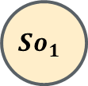

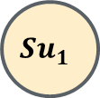






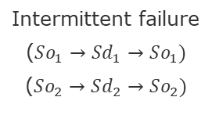
Types of Traces
$$So_{1}$$
$$Sd_{1}$$
$$So_{1}$$
$$Sd_{1}$$
$$So_{1}$$
$$Sd_{1}$$
$$So_{1}$$
$$Sd_{1}$$
$$So_{1}$$
$$Sd_{1}$$
$$Su_{1}$$
$$Su_{1}$$
$$Su_{1}$$
$$Su_{1}$$
$$Su_{1}$$
$$Su_{2}$$
$$Su_{2}$$
$$Su_{2}$$
$$Su_{2}$$
$$Su_{2}$$
$$So_{2}$$
$$Sd_{2}$$
$$So_{2}$$
$$Sd_{2}$$
$$So_{2}$$
$$Sd_{2}$$
$$So_{2}$$
$$Sd_{2}$$
$$So_{2}$$
$$Sd_{2}$$
Normal operation
$(So_{1};So_{2};So_{1})$
Intermittent failure
($So_{1}→Sd_{1}→So_{1})$
($So_{2}→Sd_{2}→So_{2})$
Systemic degradation
($Sd_{1}→Sd_{2})$
Failure masking
$(Su_{1}→Su_{2}→So_{1})$
Failure cascade
$(Sd_{1}→Su_{1}→So_{2})$
$$(Sd_{1}→Sd_{2}→Su_{2})$$

Slide 7
Collecting the data
Execute your RL environment and for each transition obtain the time since the execution started (initial timestamp minus current time).
Each tuple is composed by the transition type, transition order, timestamp.
Example: https://colab.research.google.com/github/hpi-sam/MarkovModels_Lecture/blob/main/CTMC_Transition_Timestamps.ipynb
For each episode of your agent, you will generate a sample of the timestamps for each transition.
Aggregate (join) the data from 20 episodes
This is the data that you will use to fit (learn) the density functions

Slide 8
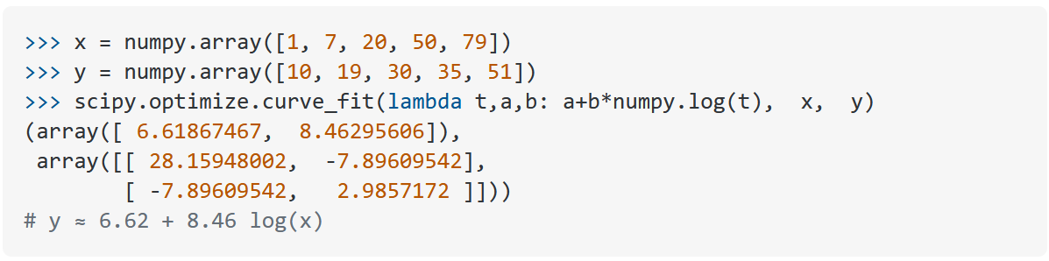
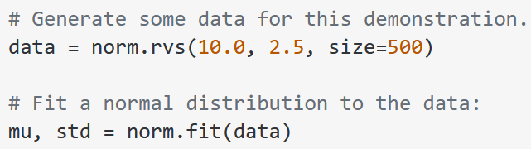
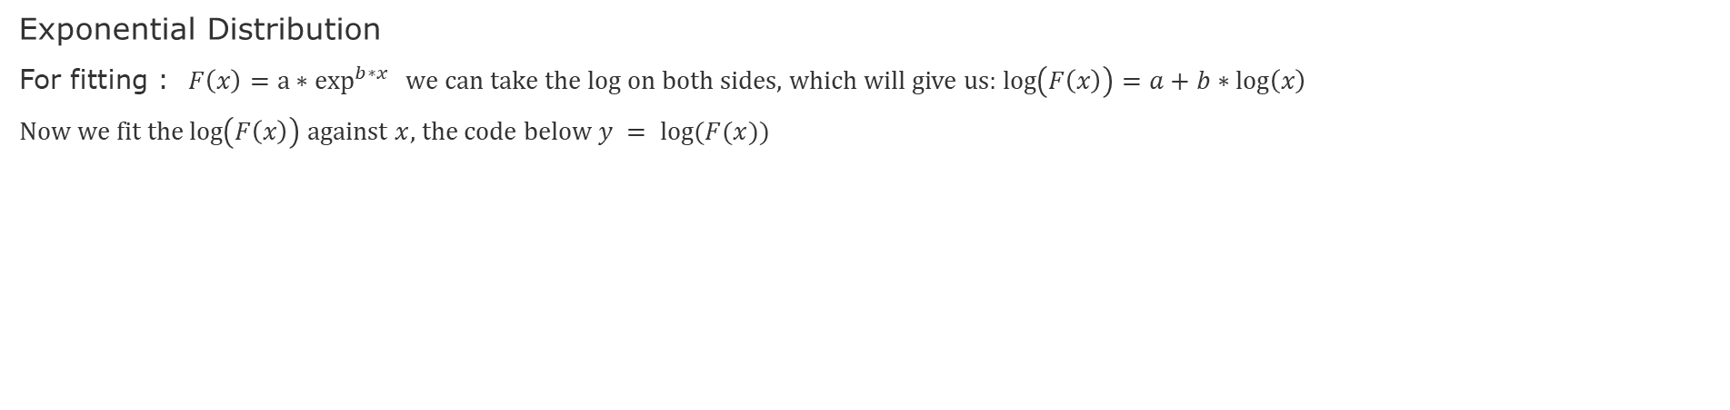
Fit Density Functions
Exponential Distribution
For fitting : $F\left(x\right)=a∗\exp^{b∗x}{ }$we can take the log on both sides, which will give us: $\log\left(F\left(x\right)\right)=a+b∗\log\left(x\right)$
Now we fit the $\log\left(F\left(x\right)\right)$ against $x$, the code below $y = log⁡(F(x))$
Normal Distribution

Slide 9
Task
Rerun the same convergence charts of Project-3 in the two scenarios:
All transitions have normal distributions
All transitions have exponential distributions

Slide 10
End

Slide 11
Supervisory Component

